Slide 1
Upconversion nanoparticle-mediated Deep Brain Stimulation
By Avery Del Grosso
10/11/19

Slide 2
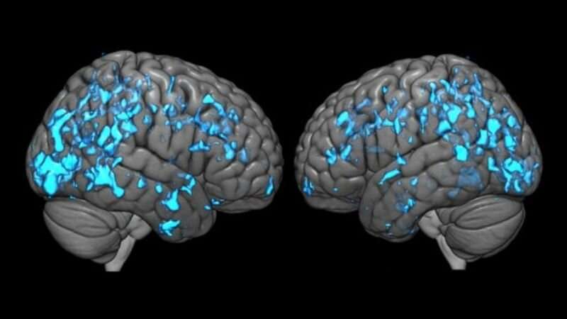
DBS (Deep Brain Stimulation)
DBS is a method of modulating dysfunctional neurocircuitry
  Parkinson’s Disease
  Tourettes
  Major Depression
  Chronic pain
Exact action mechanisms are still unclear

Slide 3
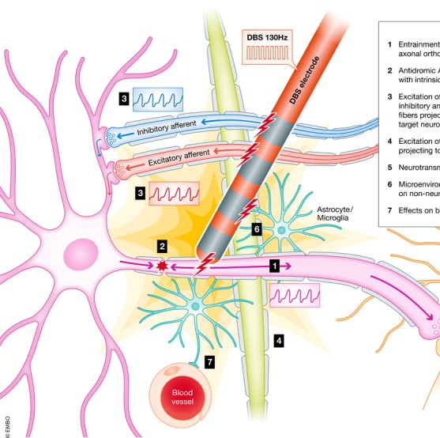
Premise of DBS
Blocks somatic action potentials
Afferent APs are stimulated
  Frequency

Slide 4
Premise of DBS
Higher, varying frequencies most efficacious
(Zhang et al., 2019)

Slide 5
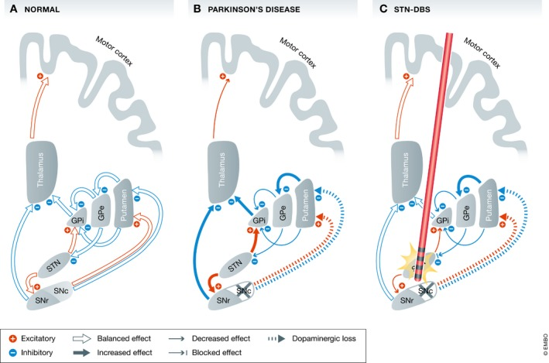
GPe: globus pallidus pars externus
GPi: globus pallidus pars internus
SNc: substantia nigra pars compacts
SNr: substantia nigra pars reticulata
STN: subthalamic nucleus.

Slide 6
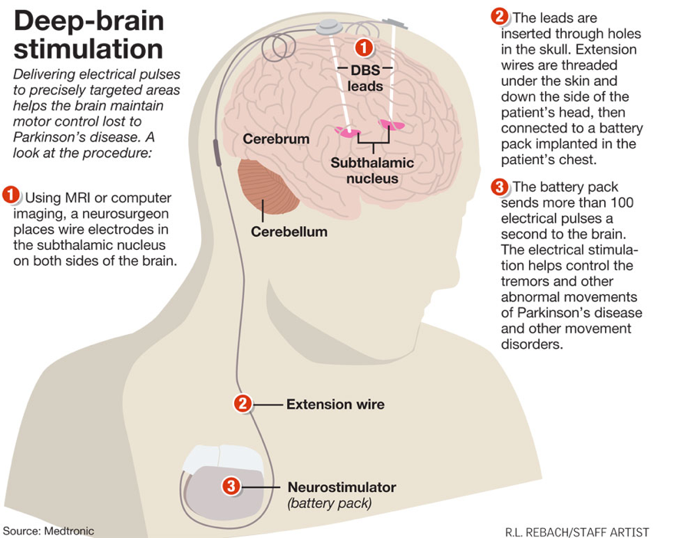
DBS Setup
Leads surgically implanted
Subthalamic nucleus for Parkinson’s

Slide 7
DBS Setup
Battery pack: 3-5 year life
Must be implanted into patient’s chest

Slide 8
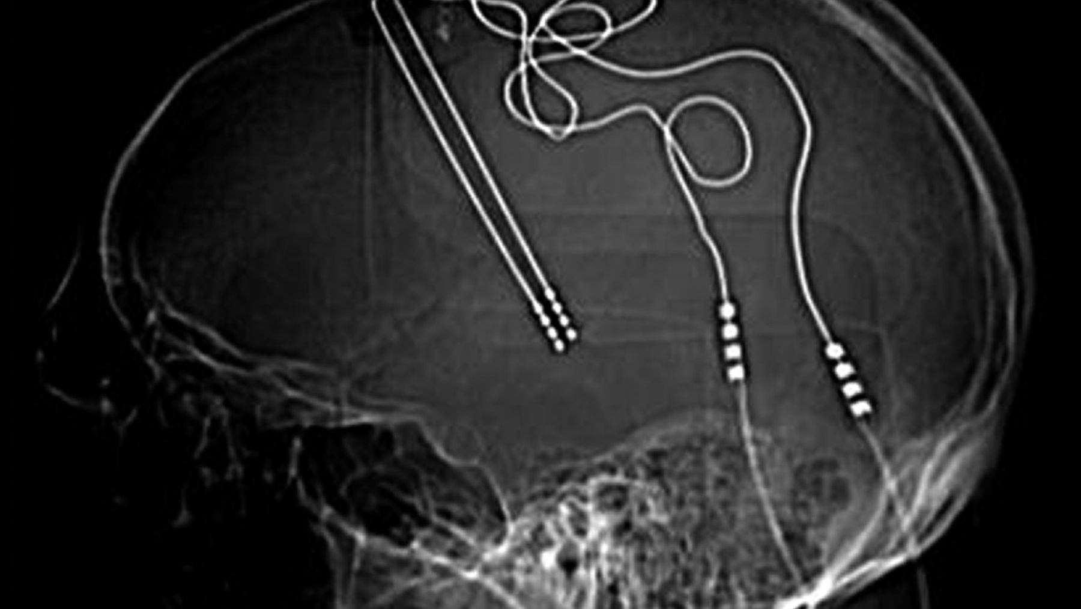
Current problems with DBS
Invasive surgery
  Permanent skull holes
  Battery pack - chest cavity
Exorbitant cost to patients
  ~$65,000 surgery
  ~$10,000-20,000 battery replacements

Slide 9
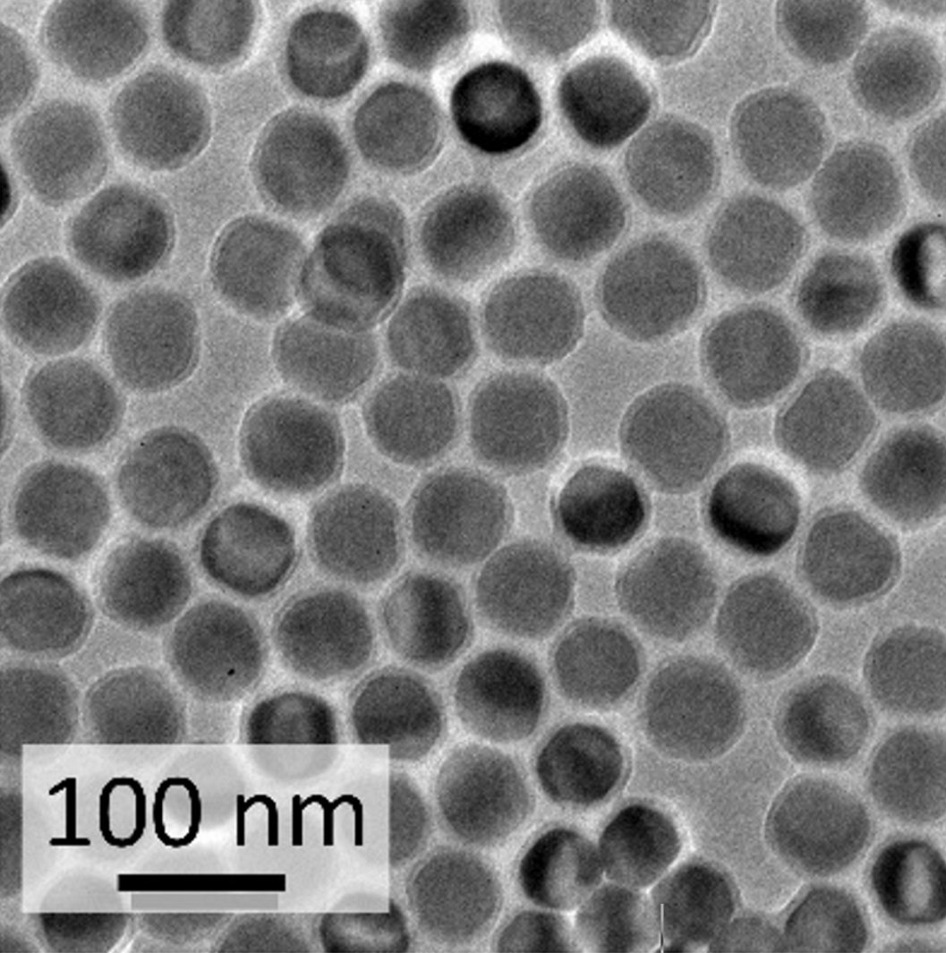
Is there a better way?
Nanoparticles, of course!
(and some optogenetics)

Slide 10
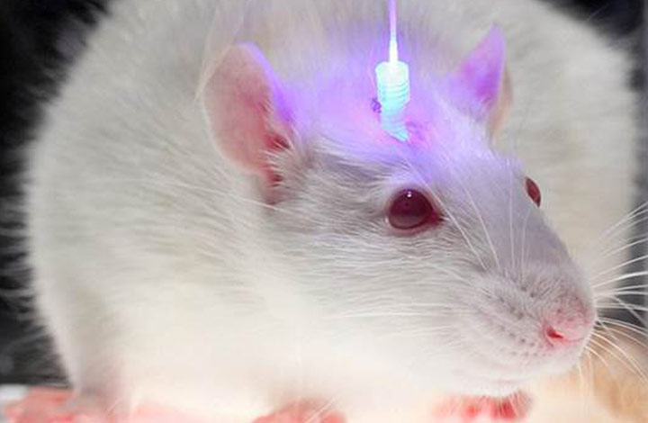
Optogenetics
Using light to control genetically-defined cells

Slide 11
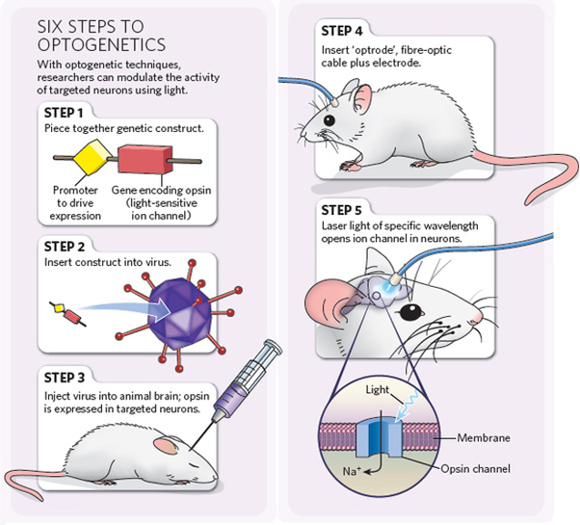
Light-sensitive opsin channels
  Triggered by wavelength
  Depolarizes neuron

Slide 12
- How can we use optogenetics for DBS?

Slide 13
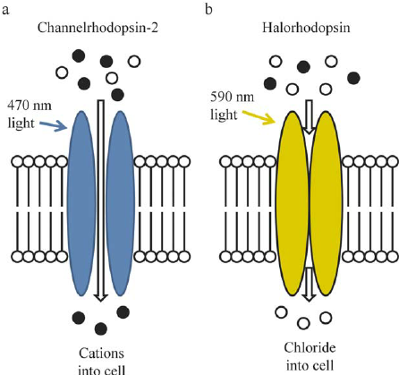
The problem with Wavelength
Channelrhodopsin-2 (primary paper opsin)
  ~470 nm light
    Scatters easily
      Endogenous chromophores

Slide 14
The problem with Wavelength
How can we efficiently activate Channelrhodopsin in neurons?
Not like this!

Slide 15
Question 1:
Can UCNPs stimulate neurons in vivo?

Slide 16
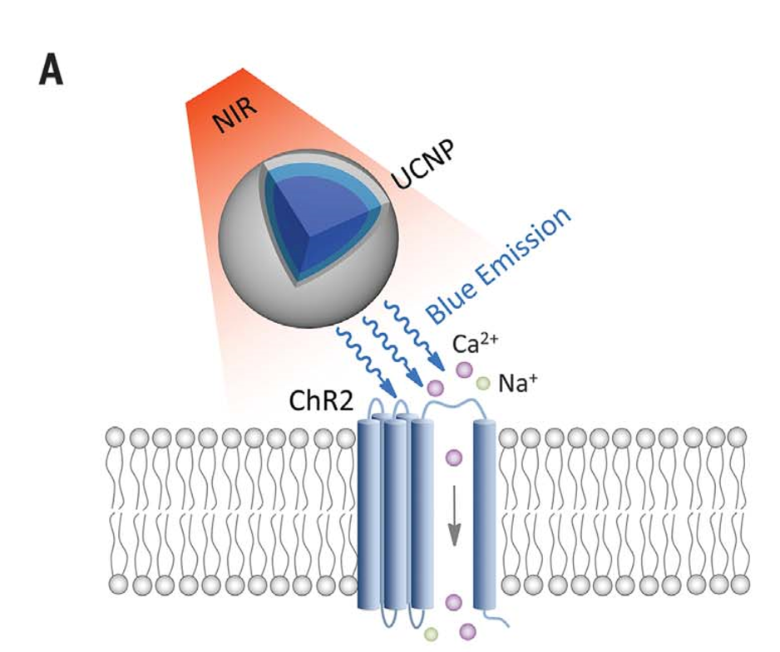
Upconversion nanoparticles
Lanthanide-doped upconversion nanoparticles (UCNP)
  Upconverts Near Infrared light

Slide 17
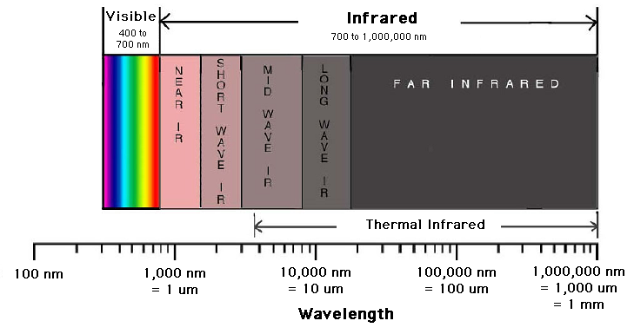
NIR (Near infrared) Light
NIR – (650 – 1350 nm)
  Light maximally penetrates
    Tissue
    Skull
    Meninges

Slide 18
UNCP Design
Yb³⁺ & Tm³⁺ host lattices = Blue emission
  Channelrhodopsin2
Yb³⁺ & Er³⁺ host lattices = Green
  Halorhodopsin/Archaerhodopsin

Slide 19
UNCP Design
^{Sodium Yttrium Fluoride NaYF}₄
  _{Optically inactive}
  ^{Inert}
  Surface quenching by solvent molecules

Slide 20
UNCP Design
^{Silica outer shell - SiO}₂
  ^{Low Biotoxicity}
  ^{Stabilizes and protects core}

Slide 22
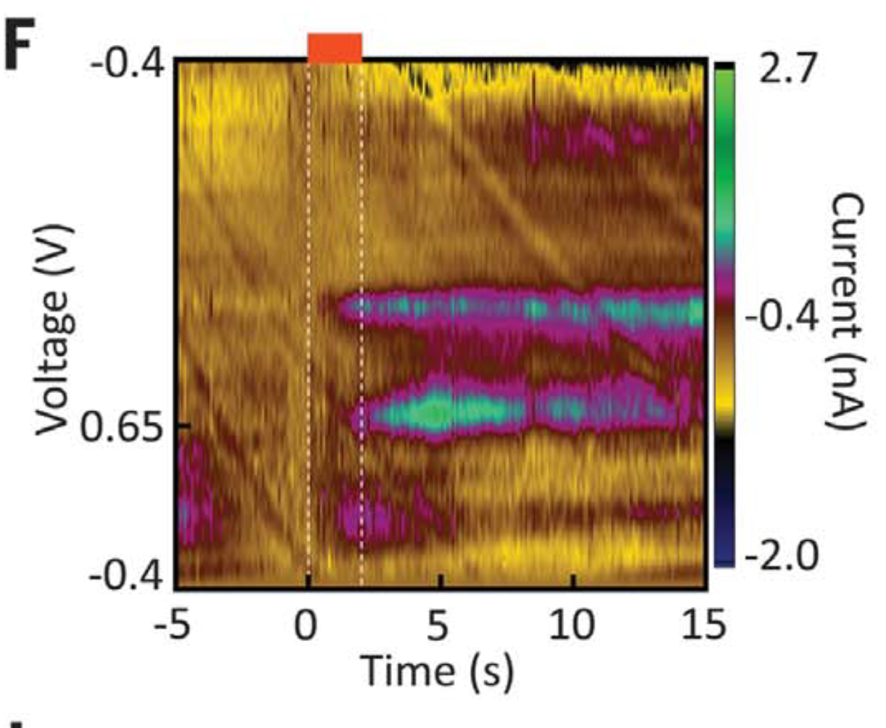

Slide 23
Notes:
Cumulative DA release within 15 s

Slide 24
Dopamine release

Slide 25
Question 2: Can UCNPs inhibit neurons?

Slide 26
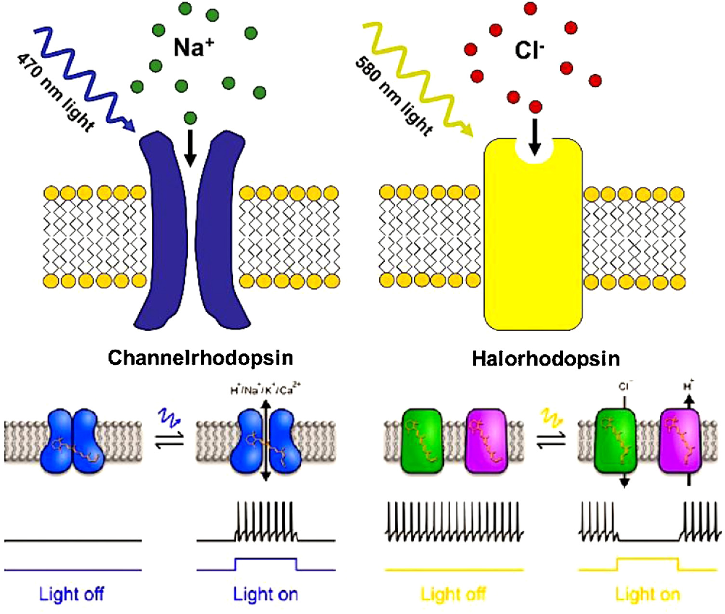
Inhibition via UNCPs
Halorhodopsin
  Influx of Cl⁻
    ^{Hyperpolarizes Cell}

Slide 27
Hippocampal Inhibition
(Dentate Gyrus)

Slide 29
Question 3:
Can UcNPs synchronize Neural activity?

Slide 30
Medial Septum modulates hippocampus
Theta waves/oscillations

Slide 32
Question 4:
Can UcNPs alter an awake animal’s behavior?

Slide 33
Hippocampal Granule Cells
  Memory

Slide 35
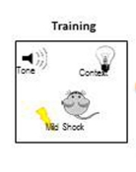
Fear conditioning mice
Basal Fear Response
A
Measured baseline freezing
Measured conditioned freezing
B
Notes:
Mice were kept on Dox and underwent five days of habituation to record their basal level of freezing in one context (context A)Next, they were taken off Dox and underwent fear conditioning in a distinct chamber (context B) in which a tone was paired with shock. The mice were then subjected to five days of testing with light-off and light-on epochs in context A while on Dox (Fig. 1c). During the habituation sessions, the Exp mice showed very little freezing during either light-off or light-on epochs. In contrast, after fear conditioning, freezing levels during light-on epochs were significantly higher compared with light-off epochs, which indicated light-induced fear memory recall (Fig. 3a). Increased freezing during light-on epochs was observed across all five days of test sessions with no discernible day-dependent difference (Supplementary Fig. 5g). These data suggest that DG cells that express endogenous c-fos during training, and therefore become labeled by ChR2-EYFP, define an active neural population that is sufficient for memory recall upon subsequent reactivation.

Slide 37
Chen – Takeaways
UCNPs can inhibit as well as stimulate APs in neurons
UCNPs can be targeted to certain areas of the brain
UCNPs can modulate behavior in an awake animal
UCNPs are nontoxic, but remain for (relatively) long-term use

Slide 38
Schmukermair
Using DBS for high anxiety and depression-like behavior

Slide 39
HAB/Nab Mice
HAB – Enhanced Depression- and Anxiety-like Behavior
NAB – Normal Depression/Anxiety Animals

Slide 40
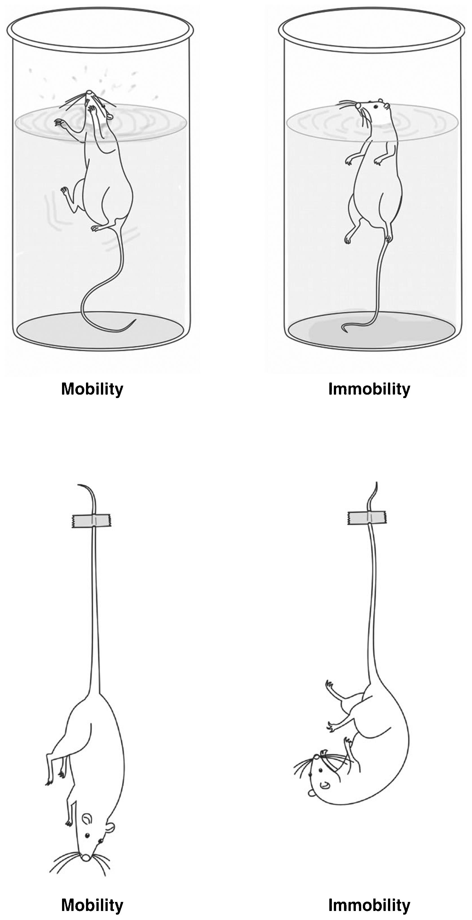

Slide 41
Treatment-resistant depression
HAB mice displayed features of TRD
SSRI’s were shown to be ineffective at mitigating symptoms
  HAB mice “behaviorally insensitive”

Slide 42
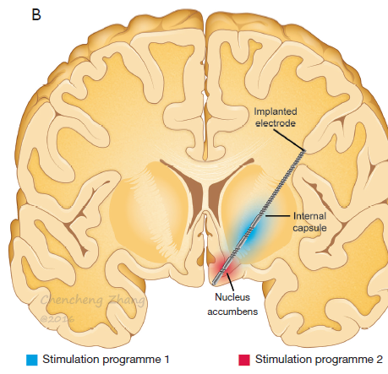
Nacb DBS
NAcb-DBS has been shown to induce:
  antidepressant
  anxiolytic
    Reduces anxiety
  And antianhedonic effects
    Anhedonia –
      Diminished pleasure, interest in rewarding activities
  efficacious in patients with TRD
    (Treatment-Resistant Depression)
  (Bewernick et al, 2012)

Slide 44
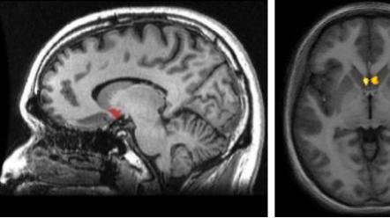
Can we combine Chen with Schmukermair?

Slide 45
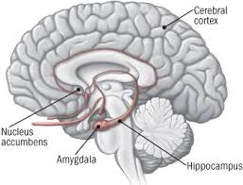
UCNPs for other Deep brain regions?
Schmukermair
  NAcb – Nucleus accumbens
    Promising DBS target
    Dopamine and serotonin are major NTs
    Plays a central role in motivation, reward circuit

Slide 46
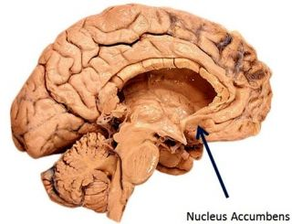
UNCPs in the nacb
Using blue-emission UNCPs
  stimulate Nacb

Slide 47
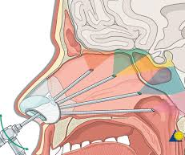
Getting NIR to the nacb
Shine NIR through cribriform plate
Cribriform plate depth:
  Keros Classification:
    type 1: 1–3 mm (26.3% of population)
    Type 2: 4–7mm (73.3% of population)
    type 3: 8–16mm (0.5% of population

Slide 48



Onwards
UCNP Improvements and other uses (Wu et al. 2016)

Slide 49
Wu et al (2016)
Organic dye-sensitized UNCPs exhibit a wider range of absorption
Elevated upconversion efficiency

Slide 51
Imaging
Dye-sensitized UNCPs can be water solubilized for imaging
  Triblock copolymer micelle
    Hydrophobic interior – encapsulates the NP
    Hydrophilic exterior – enables water solubility
Emission visible to naked eye

Slide 53
Conclusion
UNCPs are an uninvasive, efficient way to facilitate DBS
  Variety of uses – Parkinson’s, Anxiety, TRD, Etc.
Can be stimulated using transcranial NIR
Can be modified to stimulate (blue – channelrhodopsin-2) or inhibit (green – halorhodopsin)
Can be dye-sensitized for a broader absorption
Can become water soluble in a micelle for imaging in vivo

Slide 54
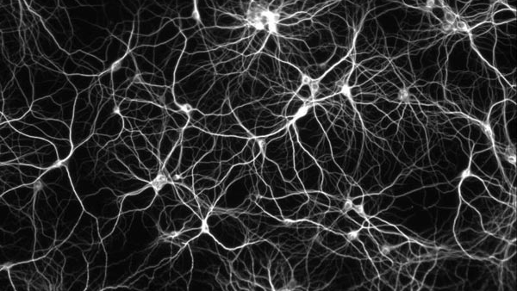
Are there other uses for UNCPs ?

